Slide 1
HND Computing Software Development: Object Oriented Programming (H171 35)
Lecturer – Dawn Wilson

Slide 2
Common interfaces of the .NET Framework Class Library
IComparable
C# contains several comparison operators (e.g., <, <=, >, >=, ==, !=) that allow you to compare simple-type values. These operators can be defined to compare two objects. Interface IComparable can also be used to allow objects of a class that implements the interface to be compared to one another.
The interface contains one method, CompareTo, that compares the object that calls the method to the object passed as an argument to the method.
Classes must implement CompareTo to return a value indicating whether the object on which it’s invoked is less than (negative integer return value), equal to (0 return value) or greater than (positive integer return value) the object passed as an argument, using any criteria you specify.
For example, if class Employee implements IComparable, its CompareTo method could compare Employee objects by their earnings amounts. Interface IComparable is commonly used for ordering objects in a collection such as an array.

Slide 3
Common interfaces of the .NET Framework Class Library
IComponent
Implemented by any class that represents a component, including Graphical User Interface (GUI) controls (such as buttons or labels).
Interface IComponent defines the behaviours that components must implement.
IEnumerator
Used for iterating through the elements of a collection (such as an array) one element at a time.
Interface IEnumerator contains method MoveNext to move to the next element in a collection
method Reset to move to the position before the first element
property Current to return the object at the current location

Slide 4
Exceptions – System.Exception
an exception indicates that a problem occurred during a program’s execution
exception handling enables you to create apps that can handle exceptions—in many cases allowing a program to continue executing as if no problems were encountered.
More severe problems may prevent a program from continuing normal execution, instead requiring the program to notify the user of the problem, then terminate in a controlled manner.
Our aim is to write clear, robust and more fault-tolerant programs

Slide 5
Preventing Errors
Typical errors arise from reading in user input, which by default will be read in as a string, then we use the “Convert” methods to convert it into it’s appropriate type e.g. int. This will fail if the input cannot be converted to this type
Another way to validate the input is to use the TryParse method, which performs the conversion only if possible.
e.g. Int32.TryParse
All of the numeric types have TryParse methods. The method requires two arguments—one is the string to parse and the other is the variable in which the converted value is to be stored. The method returns a bool value that’s true only if the string was parsed successfully. If the string could not be converted, the value is assigned to the second argument, which is passed by reference so its value can be modified in the calling method.
Method TryParse can be used to validate input in code rather than allowing the code to throw an exception—this technique is generally preferred.

Slide 6
try block
define a try block enclosing the code that might throw exceptions, as well as the code that’s skipped when an exception occurs
try
{
// Convert.ToInt32 generates FormatException
// if argument cannot be converted to an integer
Console.Write("Enter an integer numerator: ");
int numerator = Convert.ToInt32(Console.ReadLine());
Console.Write("Enter an integer denominator: ");
int denominator = Convert.ToInt32(Console.ReadLine());
// division generates DivideByZeroException
// if denominator is 0
int result = numerator / denominator;
// display result
Console.WriteLine("\nResult: {0} / {1} = {2}",
numerator, denominator, result);
continueLoop = false;
} // end try

Slide 7
Catching Exceptions
Exception-handling code appears in a catch block. In general, when an exception occurs in a try block, a corresponding catch block catches the exception and handles it.
catch (FormatException formatException)
{
Console.WriteLine("\n" + formatException.Message);
Console.WriteLine("You must enter two integers. Please try
again.\n");
} // end catch
catch (DivideByZeroException divideByZeroException)
{
Console.WriteLine("\n" + divideByZeroException.Message);
Console.WriteLine("Zero is an invalid denominator. Please try
again.\n");
}

Slide 8
Catching Exceptions
A catch block specifies an exception parameter representing the exception that the catch block can handle.
catch (FormatException formatException)
The catch block can use the parameter’s identifier (which you choose) to interact with a caught exception object.
Console.WriteLine("\n" + formatException.Message);
If there’s no need to use the exception object in the catch block, the exception parameter’s identifier can be omitted.
The type of the catch’s parameter is the type of the exception that the catch block handles.
Optionally, you can include a catch block that does not specify an exception type—such a catch block (known as a general catch clause) catches all exception types.
At least one catch block and/or a finally block (to be discussed) must immediately follow a try block.

Slide 9
Uncaught Exceptions
An uncaught exception (or unhandled exception) is an exception for which there’s no matching catch block
when uncaught exceptions occur, the app terminates early (after displaying the exception’s stack trace)
The result of an uncaught exception depends on how you execute the app i.e. using DEBUG > Start Without Debugging or DEBUG > Start Debugging
If you use the latter, the Exception Assistant window appears containing:
a line pointing from the Exception Assistant to the line of code that caused the exception
the type of the exception
Troubleshooting tips with links to helpful information on what might have caused the exception and how to handle it
links to view or copy the complete exception details

Slide 10
Termination model of exception handling
the point in the program at which an exception occurs is called the throw point - this is an important location for debugging purposes
If an exception occurs in a try block, the try block terminates immediately, and program control transfers to the first of the following catch blocks in which the exception parameter’s type matches that of the thrown exception.
After the exception is handled, program control does not return to the throw point because the try block has exited (which also causes any of its local variables to go out of scope). Rather, control resumes after the last catch block. This is known as the termination model of exception handling
If no exceptions occur in the try block, the program successfully completes the try block by ignoring the catch blocks, then the program executes the first statement following the try and catch blocks.
The try block and its corresponding catch and finally blocks together form a try statement. It’s important not to confuse the terms “try block” and “try statement”—the term “try block” refers to the block of code following the keyword try (but before any catch or finally blocks), while the term “try statement” includes all the code from the opening try keyword to the end of the last catch or finally block. This includes the try block, as well as any associated catch blocks and finally block.

Slide 11
Class System.Exception
Class Exception (namespace System) is the base class of .NET’s exception class hierarchy.
An important derived class is SystemException. The CLR generates SystemExceptions.
Many of these can be avoided if apps are coded properly. For example, if a program attempts to access an out-of-range array index, the CLR throws an exception of type IndexOutOfRangeException (a derived class of SystemException)
Similarly, an exception occurs when a program uses a reference-type variable to call a method when the reference has a value of null. This causes a NullReferenceException (another derived class of SystemException).
Other exceptions thrown by the CLR include OutOfMemoryException, StackOverflowException and ExecutionEngineException, which are thrown when something goes wrong that causes the CLR to become unstable.
Sometimes such exceptions cannot even be caught. It’s best to simply log such exceptions, then terminate your app.
Notes:
CLR – Common Language Runtime

Slide 12
Class System.Exception
A benefit of the exception class hierarchy is that a catch block can catch exceptions of a particular type or—because of the is-a relationship of inheritance—can use a base-class type to catch exceptions in a hierarchy of related exception types
e.g. we discussed the catch block with no parameter, which catches exceptions of all types (including those that are not derived from Exception). A catch block that specifies a parameter of type Exception can catch all exceptions that derive from Exception, because Exception is the base class of all exception classes.
The advantage of this approach is that the exception handler can access the caught exception’s information via the parameter in the catch.
This technique makes sense only if the handling behaviour is the same for a base class and all derived classes. Otherwise, catch each derived-class exception individually.

Slide 13
finally block
Programs frequently request and release resources dynamically (i.e. at execution time).
e.g. a program that reads a file from disk first makes a file-open request . If that request succeeds, the program reads the contents of the file. Operating systems typically prevent more than one program from manipulating a file at once. Therefore, when a program finishes processing a file, the program should close the file (i.e. release the resource) so other programs can use it.
If the file is not closed, a resource leak occurs. In such a case, the file resource is not available to other programs.
All resource release code should be moved to a finally block

Slide 14
finally block
Suppose a program places all resource-request and resource-release code in a try block. If no exceptions occur, the try block executes normally and releases the resources after using them
However, if an exception occurs, the try block may exit before the resource-release code can execute
We could duplicate all the resource-release code in each of the catch blocks, but this would make the code more difficult to modify and maintain. We could also place the resource-release code after the try statement; however, if the try block terminated due to a return statement or an exception occurred, code following the try statement would never execute.
To address these problems, C#’s exception-handling mechanism provides the finally block, which is guaranteed to execute regardless of whether the try block executes successfully or an exception occurs
This makes the finally block an ideal location in which to place resource-release code for resources that are acquired and manipulated in the corresponding try block

Slide 15
finally block
If the try block executes successfully, the finally block executes immediately after the try block terminates
If an exception occurs in the try block, the finally block executes immediately after a catch block completes
If the exception is not caught by a catch block associated with the try block, or if a catch block associated with the try block throws an exception itself, the finally block executes before the exception is processed by the next enclosing try block, which could be in the calling method.
N.B. variables that must be accessed in both a try block, and its corresponding finally block should be declared before the try block.

Slide 16
Rules of try..catch..finally
If one or more catch blocks follow a try block, the finally block is optional
However, if no catch blocks follow a try block, a finally block must appear immediately after the try block.
If any catch blocks follow a try block, the finally block (if there is one) appears after the last catch block
Only whitespace and comments can separate the blocks in a try statement.

Slide 17
Throwing exceptions using the throw statement
You can create an exception and use a throw statement to throw it
throw new Exception( "Exception in ThrowExceptionWithCatch" );
Executing the throw statement indicates that a problem has occurred in the code
Just as with exceptions thrown by the Framework Class Library’s methods and the CLR, this indicates to client apps that an error has occurred.
A throw statement specifies an object to be thrown. The operand of a throw statement can be of type Exception or of any type derived from class Exception.

Slide 18
Exception Tips
If an uncaught exception is awaiting processing when the finally block executes, and the finally block throws a new exception that’s not caught in the finally block, the first exception is lost, and the new exception is passed to the next enclosing try block.
When placing code that can throw an exception in a finally block, always enclose the code in a try statement that catches the appropriate exception types. This prevents the loss of any uncaught and rethrown exceptions that occur before the finally block executes
Do not place try blocks around every statement that might throw an exception—this can make programs difficult to read. Instead, place one try block around a significant portion of code, and follow this try block with catch blocks that handle each possible exception. Then follow the catch blocks with a single finally block. Use separate try blocks to distinguish between multiple statements that can throw the same exception type.

Slide 19
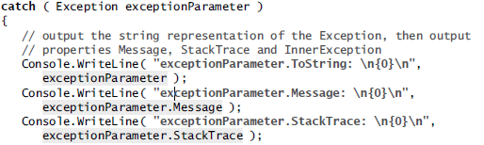
Exception Properties
exception types derive from class Exception, which has several properties. Two important properties are:
Message - stores the error message associated with an Exception object. Can be a customized message passed to an Exception object’s constructor when the Exception object is thrown
StackTrace - contains a string that represents the method-call stack which shows the series of methods that have not finished processing at the time the exception occurs

Slide 20
User-defined exception classes
User-defined exception classes should derive directly or indirectly from class Exception of namespace System
Before creating a user-defined exception class, investigate the existing exceptions in the .NET Framework Class Library to determine whether an appropriate exception type already exists.

Slide 21
class NegativeNumberException : Exception
{
// default constructor
public NegativeNumberException()
: base( "Illegal operation for a negative number" )
{
// empty body
} // end default constructor
// constructor for customizing error message
public NegativeNumberException( string messageValue )
: base( messageValue )
{
// empty body
} // end one-argument constructor
// constructor for customizing the exception's error
// message and specifying the InnerException object
public NegativeNumberException( string messageValue,
Exception inner )
: base( messageValue, inner )
{
// empty body
} // end two-argument constructor
}
Best Practice
extend class Exception,
have a class name that ends with “Exception”
define three constructors
parameterless constructor
constructor that receives a string argument (the error message)
constructor that receives a string argument and an Exception argument

Slide 22
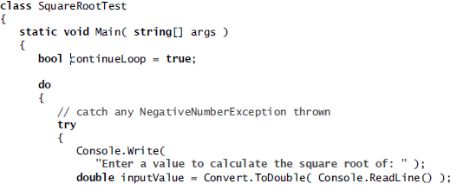
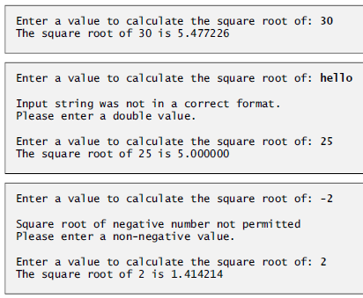
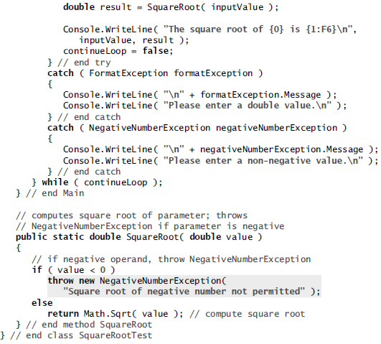
Class SquareRootTest -demonstrates our user-defined exception class

